Slide 1
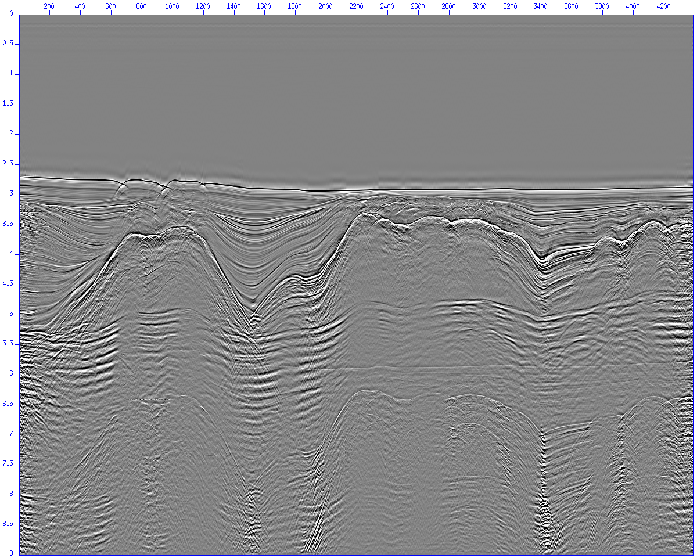
Multiple attenuation
Free surface multiple attenuation
  Stack before free surface multiple removal
Notes:
1

Slide 2
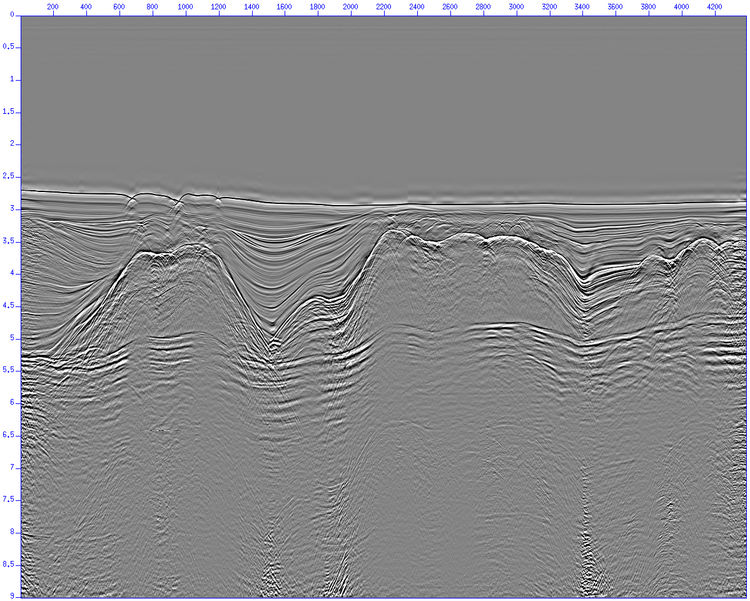
Multiple attenuation
Free surface multiple attenuation
  Stack after free surface multiple removal
Notes:
2

Slide 3
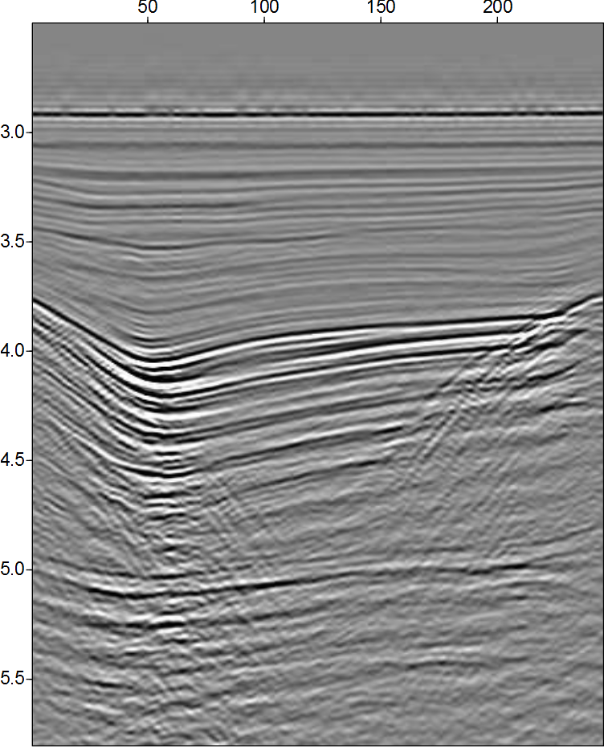
Multiple attenuation
Internal multiple attenuation results
  Common offset sections

Slide 4

Multiple attenuation
Internal multiple attenuation results
  Common offset sections

